Slide 1
数 据 库 原 理
Chp 5
Advanced SQL
王 建 民
清 华 大 学 软 件 学 院
2023年/春

Slide 2
本节课的内容
理论 | 核心知识点 | 对应章节
数据库理论 | 关系模型、关系代数、关系演算 | CHP. 2、6
数据库应用 | SQL语言、JDBC | CHP3、4、5
数据库设计 | 实体-联系图、关系范式 | CHP7、8
数据库实现 | 存贮、索引、查询、优化、 事务、并发、恢复 | CHP10、11、12、13、 14、15、16

Slide 3
Main Contents
Accessing SQL From a Programming Language
Functions and Procedural Constructs
Triggers
Recursive Queries

Slide 4
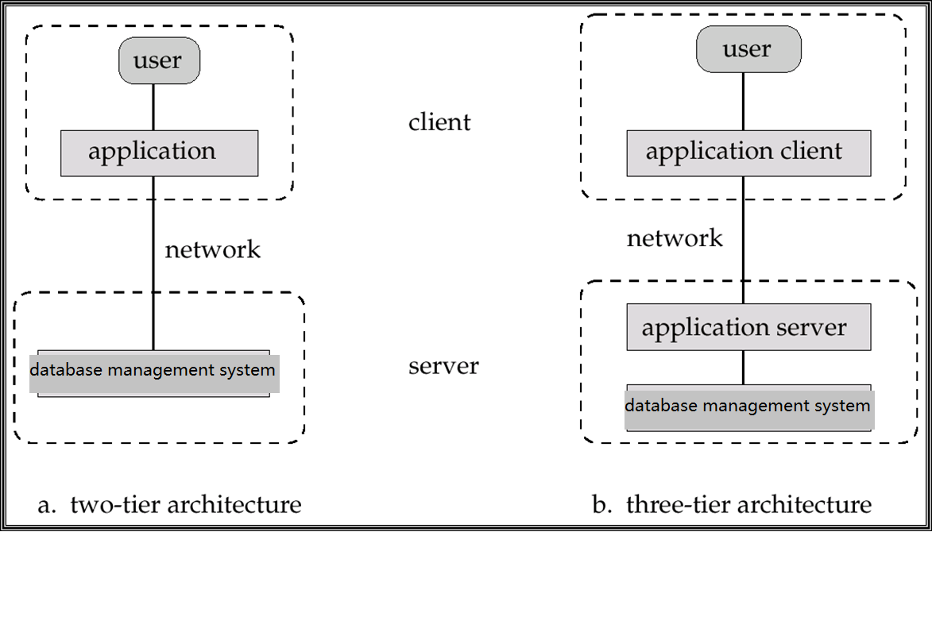
数据库系统
前端编程
JDBC/ODBC
Two-tier architecture: E.g. client programs using ODBC/JDBC to communicate with a database
Three-tier architecture: E.g. web-based applications, and applications built using “middleware”
Database System Architectures

Slide 5
用高级程序语言访问数据库
API (application-program interface) for a program to interact with a database server
Application makes calls to
Connect with the database server
Send SQL commands to the database server
Fetch tuples of result one-by-one into program variables
注意：今天的数据库服务器都是运行在网上、云上的
Notes:
ODBC was originally developed by Microsoft and Simba Technologies during the early 1990s, and became the basis for the Call Level Interface (CLI) standardized by SQL Access Group in the Unix and mainframe field.

Slide 6
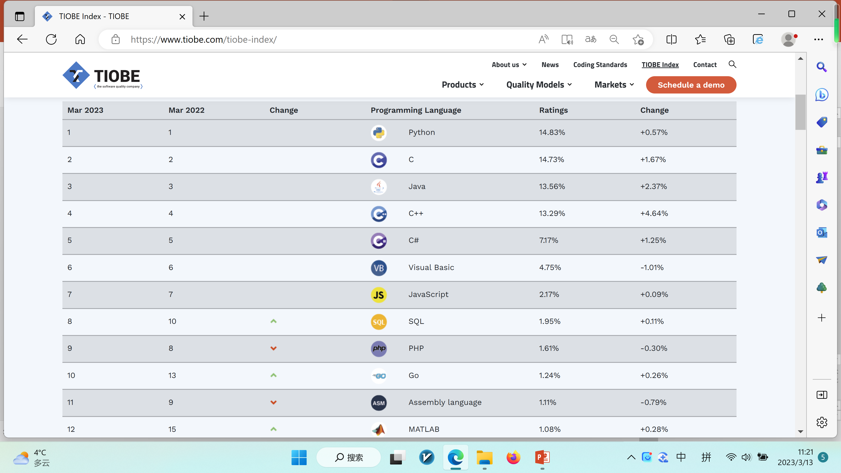
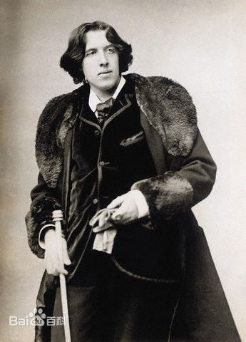
有趣的网站https://www.tiobe.com/tiobe-index/
March 2023
the popularity of PL
The Importance Of
Being Earnest
《不可儿戏》
奥斯卡·王尔德
19世纪英国最伟大的
作家与艺术家之一

Slide 7
计算机程序访问数据库三种机制
JDBC
(Java Database Connectivity) works with Java
ODBC
(Open Database Connectivity) works with C, C++, C#, and Visual Basic. Other API’s such as ADO.NET sit on top of ODBC
Embedded SQL
Notes:
ODBC was originally developed by Microsoft and Simba Technologies during the early 1990s, and became the basis for the Call Level Interface (CLI) standardized by SQL Access Group in the Unix and mainframe field.

Slide 8
JDBC
JDBC is a Java API for communicating with database systems supporting SQL.
JDBC supports a variety of features for querying and updating data, and for retrieving query results.
- Data Manipulation Language
JDBC also supports metadata retrieval, such as querying about relations present in the database and the names and types of relation attributes.
- Data Definition Language

Slide 9
JDBC
Steps for communicating with the database:
Open a connection
Create a “statement” object
Execute queries using the Statement object to send queries and fetch results
Exception mechanism to handle errors

Slide 10
JDBC Code
透过JDBC连接HSQLDB的JAVA程序
public static void JDBCexample(String dbid, String userid, String passwd)
{
try {
Class.forName ("org.hsqldb.jdbc.JDBCDriver");
Connection conn = DriverManager.getConnection( "jdbc:hsqldb:hsql://localhost/","SA","");
Statement stmt = conn.createStatement();
… Do Actual Work ….
stmt.close();
conn.close();
}
catch (SQLException sqle) {
System.out.println("SQLException : " + sqle);
}
}

Slide 11
JDBC Code (C1)
Update to database try { stmt.executeUpdate( "insert into instructor values(’77987’, ’Kim’, ’Physics’, 98000)"); } catch (SQLException sqle) { System.out.println("Could not insert tuple. " + sqle); }
Execute query and fetch and print results
ResultSet rset = stmt.executeQuery( "select dept_name, avg (salary) from instructor group by dept_name"); while (rset.next()) { System.out.println(rset.getString("dept_name") + " " + rset.getFloat(2)); }

Slide 12
JDBC Code Details
Getting result fields
rset.getString(“dept_name”) and rset.getString(1) equivalent if dept_name is the first argument of select result.
Dealing with Null values
int a = rset.getInt(“a”);
if (rset.wasNull()) Systems.out.println(“Got null value”);

Slide 13
Prepared Statement
PreparedStatement pStmt = conn.prepareStatement( "insert into instructor values(?,?,?,?)"); pStmt.setString(1, "88877"); pStmt.setString(2, "Perry"); pStmt.setString(3, "Finance"); pStmt.setInt(4, 125000); pStmt.executeUpdate(); pStmt.setString(1, "88878"); pStmt.executeUpdate();
For queries, use pStmt.executeQuery(), which returns a ResultSet
WARNING: always use prepared statements when taking an input from the user and adding it to a query
NEVER create a query by concatenating strings which you get as inputs
"insert into instructor values(’ " + ID + " ’, ’ " + name + " ’, " + " ’ " + dept_name + " ’, " + balance + ") "
What if name is “D’Souza”?
Notes:
PreparedStatement pStmt = conn.prepareStatement( "insert into instructor values(?,?,?,?)"); pStmt.setString(1, "88877"); pStmt.setString(2, "Perry"); pStmt.setString(3, "Finance"); pStmt.setInt(4, 125000); pStmt.executeUpdate(); pStmt.setString(1, "88878"); pStmt.executeUpdate();

Slide 14
SQL Injection
Suppose query is constructed using
"select * from instructor where name = ’" + name + "’"
Suppose the user, instead of entering a name, enters:
X’ or ’Y’ = ’Y
then the resulting statement becomes:
"select * from instructor where name = ’" + "X’ or ’Y’ = ’Y" + "’"
which is:
select * from instructor where name = ’X’ or ’Y’ = ’Y’
User could have even used
X’; update instructor set salary = salary + 10000; --
Prepared statement internally uses: "select * from instructor where name = ’X\’ or \’Y\’ = \’Y’
Always use prepared statements, with user inputs as parameters

Slide 15
Metadata Features
ResultSet metadata
after executing query to get a ResultSet rs:
ResultSetMetaData rsmd = rset.getMetaData();
for(int i = 1; i <= rsmd.getColumnCount(); i++) {
System.out.println(rsmd.getColumnName(i));
System.out.println(rsmd.getColumnTypeName(i));
}
How is this useful?

Slide 16
Metadata (C1)
Database metadata
DatabaseMetaData dbmd = conn.getMetaData();
ResultSet rs = dbmd.getColumns(null, "univdb", "department", "%");
// Arguments to getColumns: Catalog, Schema-pattern, Table-pattern,
// and Column-Pattern
// Returns: One row for each column; row has a number of attributes
// such as COLUMN_NAME, TYPE_NAME
while( rs.next()) {
System.out.println(rs.getString("COLUMN_NAME");
System.out.println( rs.getString("TYPE_NAME");
}

Slide 17
Transaction Control in JDBC
By default, each SQL statement is treated as a separate transaction that is committed automatically
Can turn off automatic commit on a connection
conn.setAutoCommit(false);
Transactions must then be committed or rolled back explicitly
conn.commit(); or
conn.rollback();
conn.setAutoCommit(true) turns on automatic commit.

Slide 18
Other JDBC Features
Calling functions and procedures
CallableStatement cStmt1 = conn.prepareCall("{? = call some function(?)}");
CallableStatement cStmt2 = conn.prepareCall("{call some procedure(?,?)}");

Slide 19
Other JDBC Features
Handling large object types
getBlob() and getClob() that are similar to the getString() method, but return objects of type Blob and Clob, respectively
get data from these objects by getBytes()
associate an open stream with Java Blob or Clob object to update large objects
blob.setBlob(int parameterIndex, InputStream inputStream).

Slide 20
ODBC
Open DataBase Connectivity (ODBC) standard
standard for application program to communicate with a database server.
application program interface (API) to
open a connection with a database,
send queries and updates,
get back results.
Applications such as GUI, spreadsheets, etc. can use ODBC
ODBC was originally developed by Microsoft and Simba Technologies during the early 1990s
Notes:
ODBC was originally developed by Microsoft and Simba Technologies during the early 1990s, and became the basis for the Call Level Interface (CLI) standardized by SQL Access Group in the Unix and mainframe field.

Slide 21
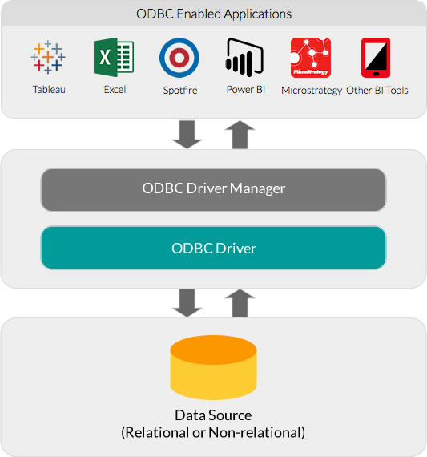
ODBC Architecture

Slide 22
嵌入式SQL
The SQL standard defines embeddings of SQL in a variety of programming languages such as C, C++, Java, Fortran, etc.
A language to which SQL queries are embedded is referred to as a host language, and the SQL structures permitted in the host language comprise embedded SQL.
The basic form of these languages follows that of the System R embedding of SQL into PL/1.

Slide 23
嵌入式SQL(C1)
EXEC SQL statement is used to identify embedded SQL request to the preprocessor
EXEC SQL <embedded SQL statement >;
Note: this varies by language:
In some languages, like COBOL, the semicolon is replaced with END-EXEC
In Java embedding uses # SQL { …. };

Slide 24
嵌入式SQL(C2)
Before executing any SQL statements, the program must first connect to the database. This is done using:
EXEC-SQL connect to server user user-name using password;
Here, server identifies the server to which a connection is to be established.
Variables of the host language can be used within embedded SQL statements. They are preceded by a colon (:) to distinguish from SQL variables (e.g., :credit_amount )

Slide 25
嵌入式SQL(C3)
Variables used as above must be declared within DECLARE section, as illustrated below. The syntax for declaring the variables, however, follows the usual host language syntax.
EXEC-SQL BEGIN DECLARE SECTION
int credit-amount ;
EXEC-SQL END DECLARE SECTION;
To write an embedded SQL query, we use the
declare c cursor for <SQL query>
statement. The variable c is used to identify the query

Slide 26
嵌入式SQL(C4)
Example:
From within a host language, find the ID and name of students who have completed more than the number of credits stored in variable credit_amount in the host langue
Specify the query in SQL as follows:
EXEC SQL
declare c cursor for select ID, name from student where tot_cred > :credit_amount
END_EXEC
The variable c (used in the cursor declaration) is used to identify the query

Slide 27
嵌入式SQL(C5)
The open statement for our example is as follows:
EXEC SQL open c ;
This statement causes the database system to execute the query and to save the results within a temporary relation. The query uses the value of the host-language variable credit-amount at the time the open statement is executed.
The fetch statement causes the values of one tuple in the query result to be placed on host language variables.
EXEC SQL fetch c into :si, :sn END_EXEC
Repeated calls to fetch get successive tuples in the query result

Slide 28
嵌入式SQL(C6)
A variable called SQLSTATE in the SQL communication area (SQLCA) gets set to ‘02000’ to indicate no more data is available
The close statement causes the database system to delete the temporary relation that holds the result of the query.
EXEC SQL close c ;
Note: above details vary with language. For example, the Java embedding defines Java iterators to step through result tuples.

Slide 29
Updates Through Embedded SQL
Embedded SQL expressions for database modification (update, insert, and delete)
Can update tuples fetched by cursor by declaring that the cursor is for update
EXEC SQL
declare c cursor for select * from instructor where dept_name = ‘Music’ for update
We then iterate through the tuples by performing fetch operations on the cursor (as illustrated earlier), and after fetching each tuple we execute the following code:
update instructor set salary = salary + 1000 where current of c

Slide 30
Main Contents
Accessing SQL From a Programming Language
Functions and Procedural Constructs
Triggers
Recursive Queries

Slide 31
数据库系统
前端编程
后端编程
存储过程/触发器
Two-tier architecture: E.g. client programs using ODBC/JDBC to communicate with a database
Three-tier architecture: E.g. web-based applications, and applications built using “middleware”
Database System Architectures

Slide 32
函数与过程
SQL:1999 supports functions and procedures
Functions/procedures can be written in SQL itself, or in an external programming language
Functions are particularly useful with specialized data types such as images and geometric objects
Example: functions to check if polygons overlap, or to compare images for similarity
Some database systems support table-valued functions, which can return a relation as a result

Slide 33
函数与过程(c1)
HSQL的存储过程
CREATE PROCEDURE
get_instructor(IN p_id INT, OUT deptname VARCHAR(20))
READS SQL DATA
BEGIN ATOMIC
SELECT dept_name INTO deptname FROM instructor WHERE id = p_id;
END

Slide 34
SQL 函数
Define a function that, given the name of a department, returns the count of the number of instructors in that department.
create function dept_count (dept_name varchar(20))
returns integer
READS SQL DATA
begin ATOMIC
declare d_count integer;
select count (* ) into d_count
from instructor
where instructor.dept_name = dept_name;
return d_count;
end
HSQL的函数定义

Slide 35
SQL 函数(C1)
The function dept_count can be used to find the department names and budget of all departments with more that 10 instructors.
select dept_name, budget from department where dept_count (dept_name ) > 10
Notes:
CREATE PROCEDURE get_instructor(IN p_id INT, OUT deptname VARCHAR(20))
READS SQL DATA
BEGIN ATOMIC
SELECT dept_name INTO deptname FROM instructor WHERE id = p_id;
END

Slide 36
SQL 函数 (C2)
Compound statement: begin … end
May contain multiple SQL statements between begin and end.
returns -- indicates the variable-type that is returned (e.g., integer)
return -- specifies the values that are to be returned as result of invoking the function
SQL function are in fact parameterized views that generalize the regular notion of views by allowing parameters.
Notes:
CREATE PROCEDURE get_customer(IN p_id INT, OUT p_firstname VARCHAR(50), OUT p_lastname VARCHAR(50)) READS SQL DATA BEGIN ATOMIC -- this statement uses the p_id to get firstname and lastname SELECT firstname, lastname INTO p_firstname, p_lastname FROM customers WHERE id = p_id; END

Slide 37
Table 函数
SQL:2003 added functions that return a relation as a result
Example: Return all instructors in a given department
create function instructor_of (dept_name char(20))
returns table (
ID varchar(5), name varchar(20), dept_name varchar(20), salary numeric(8,2))
return table (select ID, name, dept_name, salary from instructor where instructor.dept_name = instructor_of.dept_name)
Usage
select * from table (instructor_of (‘Music’))

Slide 38
SQL 存储过程
The dept_count function could instead be written as procedure:
create procedure dept_count_proc (in dept_name varchar(20), out d_count integer) begin
select count(*) into d_count from instructor where instructor.dept_name = dept_count_proc.dept_name
end

Slide 39
SQL 存储过程(C1)
Procedures can be invoked either from an SQL procedure or from embedded SQL, using the call statement.
declare d_count integer; call dept_count_proc( ‘Physics’, d_count);
Procedures and functions can be invoked also from dynamic SQL
SQL:1999 allows more than one function/procedure of the same name (called name overloading), as long as the number of arguments differ, or at least the types of the arguments differ

Slide 40
控制结构
SQL supports constructs that gives it almost all the power of a general-purpose programming language.
Warning: most database systems implement their own variant of the standard syntax below.
Compound statement: begin … end,
May contain multiple SQL statements between begin and end.
Local variables can be declared within a compound statements

Slide 41
控制结构(C1)
while boolean expression do
sequence of statements ;
end while
repeat
sequence of statements ;
until boolean expression
end repeat

Slide 42
控制结构(C2)
For loop
Permits iteration over all results of a query
Example: Find the budget of all departments declare n integer default 0; for r as select budget from department do set n = n + r.budget end for

Slide 43
控制结构(C3)
Conditional statements (if-then-else) SQL:1999 also supports a case statement similar to C case statement

Slide 44
控制结构(C4)
Signaling of exception conditions, and declaring handlers for exceptions
declare out_of_classroom_seats condition
declare exit handler for out_of_classroom_seats begin … end
The handler here is exit -- causes enclosing begin..end to be exited
Other actions possible on exception

Slide 45
外部语言程序
SQL:1999 permits the use of functions and procedures written in other languages such as C or C++
Declaring external language procedures and functions
create procedure dept_count_proc(in dept_name varchar(20), out count integer) language C external name ’ /usr/avi/bin/dept_count_proc’ create function dept_count(dept_name varchar(20)) returns integer language C external name ‘/usr/avi/bin/dept_count’

Slide 46
外部语言程序- ELR
SQL:1999 allows the definition of procedures in an imperative programming language, (Java, C#, C or C++) which can be invoked from SQL queries.
Functions defined in this fashion can be more efficient than functions defined in SQL, and computations that cannot be carried out in SQL can be executed by these functions.
Declaring external language procedures and functions
create procedure dept_count_proc(in dept_name varchar(20), out count integer) language C external name ’ /usr/avi/bin/dept_count_proc’ create function dept_count(dept_name varchar(20)) returns integer language C external name ‘/usr/avi/bin/dept_count’

Slide 47
外部语言程序-Drawbacks
Code to implement function may need to be loaded into database system and executed in the database system’s address space.
risk of accidental corruption of database structures
security risk, allowing users access to unauthorized data
There are alternatives, which give good security at the cost of potentially worse performance.
Direct execution in the database system’s space is used when efficiency is more important than security.

Slide 48
Main Contents
Accessing SQL From a Programming Language
Functions and Procedural Constructs
Triggers
Recursive Queries

Slide 49
触发器- Triggers
A trigger is a statement that is executed automatically by the system as a side effect of a modification to the database
To design a trigger mechanism, we must
Specify the conditions under which the trigger is to be executed
Specify the actions to be taken when the trigger executes

Slide 50
Event-Condition-Action Rules
Another name for “trigger” is ECA rule, or event-condition-action rule
Event : typically a type of database modification
Insert, Update, Delete
Condition : Any SQL boolean-valued expression
Action : Any SQL statements

Slide 51
Triggering Events and Actions in SQL
Triggers on update can be restricted to specific attributes
For example, after update of takes on grade
Values of attributes before and after an update can be referenced
referencing old row as : for deletes and updates
referencing new row as : for inserts and updates

Slide 52
Triggering Events and Actions in SQL
Triggers can be activated before an event, which can serve as extra constraints. For example, convert blank grades to null.
create trigger setnull_trigger before update of takes referencing new row as nrow for each row when (nrow.grade = ‘ ‘) begin atomic set nrow.grade = null; end;

Slide 53
Trigger to Maintain credits_earned value
create trigger credits_earned after update of takes on (grade) referencing new row as nrow referencing old row as orow for each row when nrow.grade <> ’F’ and nrow.grade is not null and (orow.grade = ’F’ or orow.grade is null) begin atomic update student set tot_cred= tot_cred + (select credits from course where course.course_id= nrow.course_id) where student.id = nrow.id; end;

Slide 54
Statement Level Triggers
Instead of executing a separate action for each affected row, a single action can be executed for all rows affected by a transaction
Use for each statement instead of for each row
Use referencing old table or referencing new table to refer to temporary tables (called transition tables) containing the affected rows
Can be more efficient when dealing with SQL statements that update a large number of rows

Slide 55
When Not To Use Triggers
Triggers were used earlier for tasks such as
Maintaining summary data (e.g., total salary of each department)
Replicating databases by recording changes to special relations (called change or delta relations) and having a separate process that applies the changes over to a replica
There are better ways of doing these now:
Databases today provide built in materialized view facilities to maintain summary data
Databases provide built-in support for replication

Slide 56
When Not To Use Triggers (C1)
Encapsulation facilities can be used instead of triggers in many cases
Define methods to update fields
Carry out actions as part of the update methods instead of through a trigger
Risk of unintended execution of triggers, for example, when
Loading data from a backup copy
Replicating updates at a remote site
Trigger execution can be disabled before such actions.

Slide 57
Main Contents
Accessing SQL From a Programming Language
Functions and Procedural Constructs
Triggers
Recursive Queries

Slide 58
A question in Chp 3. Slides Page 24
Relation emp-super
person supervisor
Bob Alice
Mary Susan
Alice David
David Mary
Find the supervisor of “Bob”
Find the supervisor of the supervisor of “Bob”
Find ALL the supervisors (direct and indirect) of “Bob”

Slide 59
Simple Recursion Example in HSQL
CREATE TABLE proptree (pid INT, id INT);
INSERT INTO proptree VALUES (1,2), (1,3),(2,4);
WITH RECURSIVE tree (par, child) AS (
select pid, id from pptree
UNION
SELECT pid, tree.child FROM proptree, tree WHERE id = par) SELECT * FROM tree;
INSERT INTO PROPTREE
WITH …

Slide 60
Recursion Example in SQL
find which courses are a prerequisite, whether directly or indirectly, for a specific course with recursive rec_prereq(course_id, prereq_id) as ( select course_id, prereq_id from prereq union select rec_prereq.course_id, prereq.prereq_id from rec_prereq, prereq where rec_prereq.prereq_id = prereq.course_id ) select * from rec_prereq;
This example view, rec_prereq, is called the transitive closure of the prereq relation

Slide 61
Recursion Example in SQL
Recursive member
find which courses are a prerequisite, whether directly or indirectly, for a specific course with recursive rec_prereq(course_id, prereq_id) as ( select course_id, prereq_id from prereq union select rec_prereq.course_id, prereq.prereq_id from rec_prereq, prereq where rec_prereq.prereq_id = prereq.course_id ) select * from rec_prereq;
This example view, rec_prereq, is called the transitive closure of the prereq relation
基础查询，Anchor member
递归成员，
Recursive member

Slide 62
The Power of Recursion
Computing transitive closure using iteration, adding successive tuples to rec_prereq
Each step of the iterative process constructs an extended version of rec_prereq from its recursive definition.
The final result is called the fixed point of the recursive view definition.
Recursive views are required to be monotonic. That is, if we add tuples to prereq the view rec_prereq contains all of the tuples it contained before, plus possibly more
Notes:
62

Slide 63
End of Chapter 5

